Slide 1
OQA module
Classical description of a quantum emitter
Thierry Grosjean
DR, CNRS
Institut FEMTO-ST
03 81 66 64 17
thierry.grosjean@univ-fcomte.fr

Slide 2
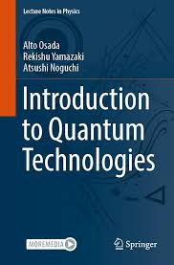
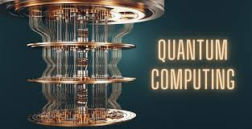
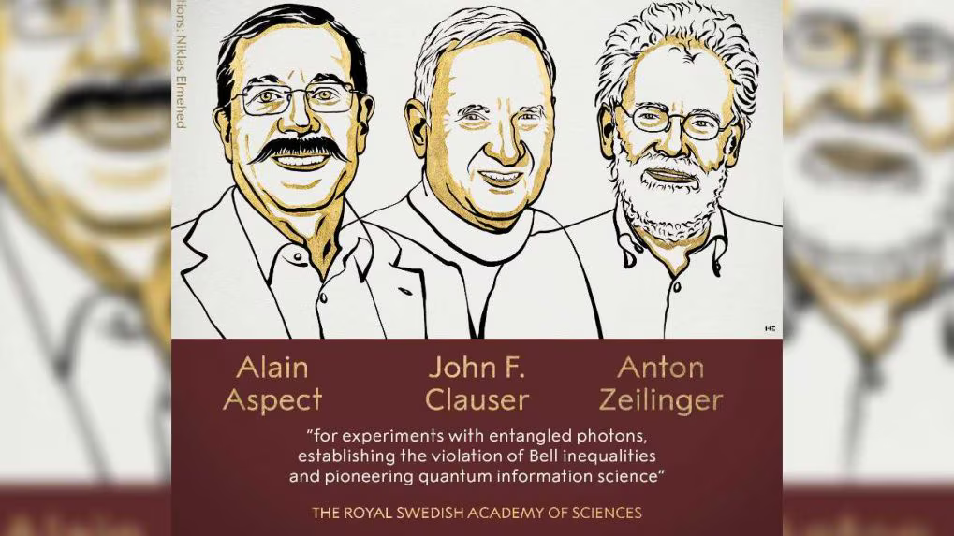
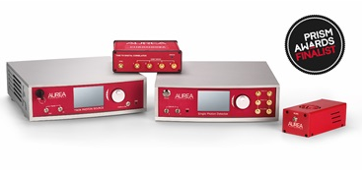
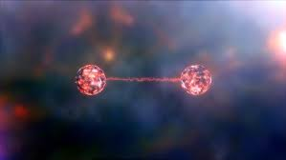

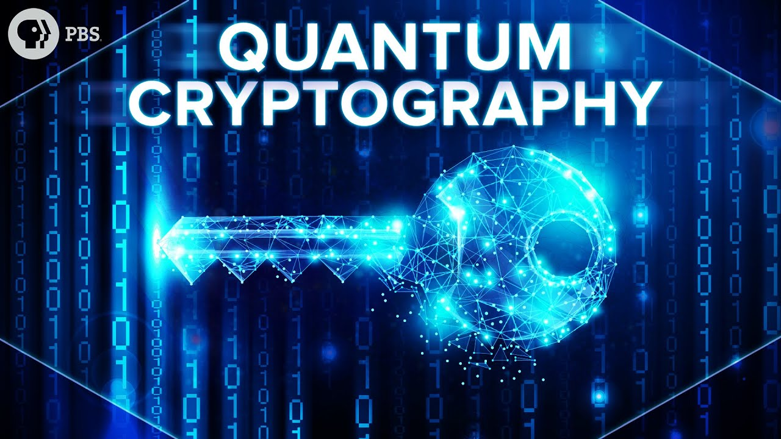
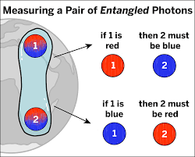
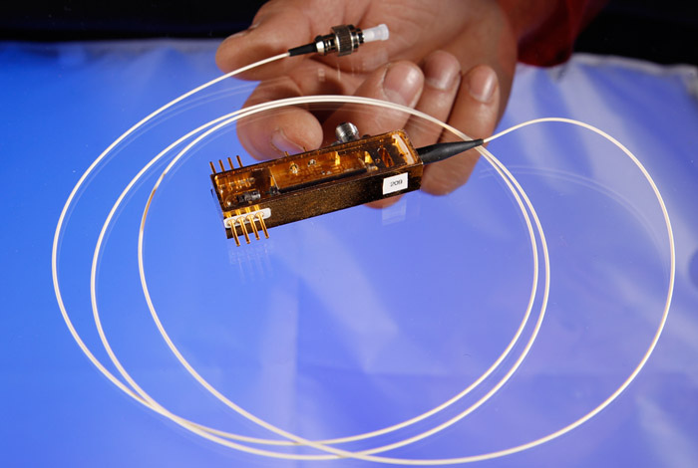

Slide 3


Quantum technologies
OPTICS
/ Photons
Manipulation of single photons
Where do they come from ???
Single photon generator ???

Slide 4
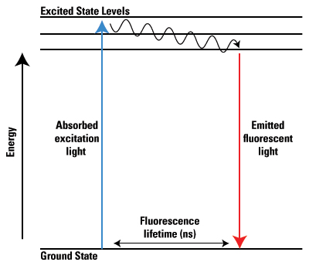

Single photon emission: fluorescence
A model of a fluorescent emitter:
➔2 energy levels (2 states: fundamental / excited)
1 emitted photon
1 photon
absorbé
hν1
hν2
ν1 > ν2

Slide 5
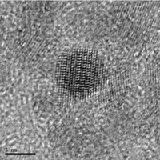
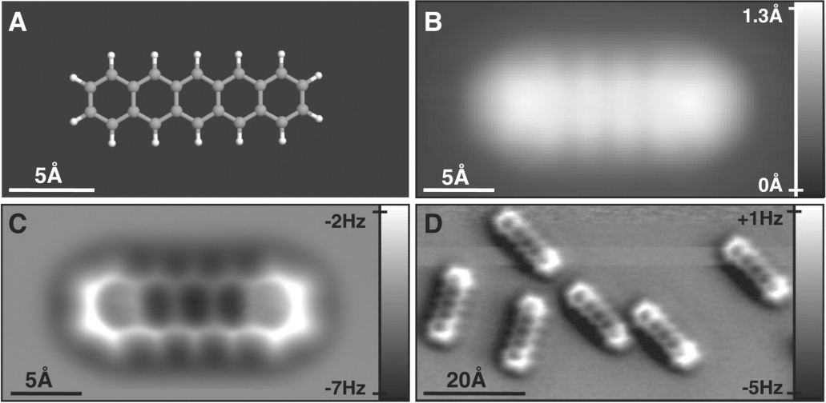
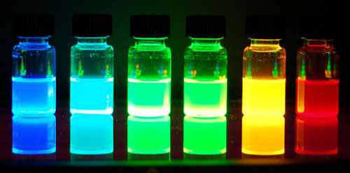
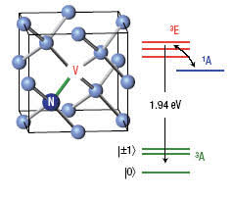
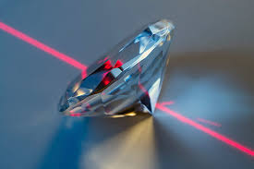
Colloidal quantum dots
Fluorescence molecules
NV color centers in diamond

Slide 6
Quantum emitters
- Point-like emitters of light (nanometer scale) : atoms, molecules , nanoparticules.
Internal energy levels ➔ light matter interaction: ground and excited states: emission shows discrete spectral peaks
Spontaneous emission of photons (no stimulated emission)

Slide 7
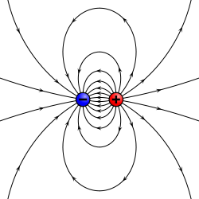
Quantum emitters
- Point-like emitters of light (nanometer scale) : atoms, molecules , nanoparticules.
Internal energy levels ➔ light matter interaction: ground and excited states: emission shows discrete spectral peaks
Spontaneous emission of photons (no stimulated emission)
From a classical point of view ??
The dipole

Slide 8
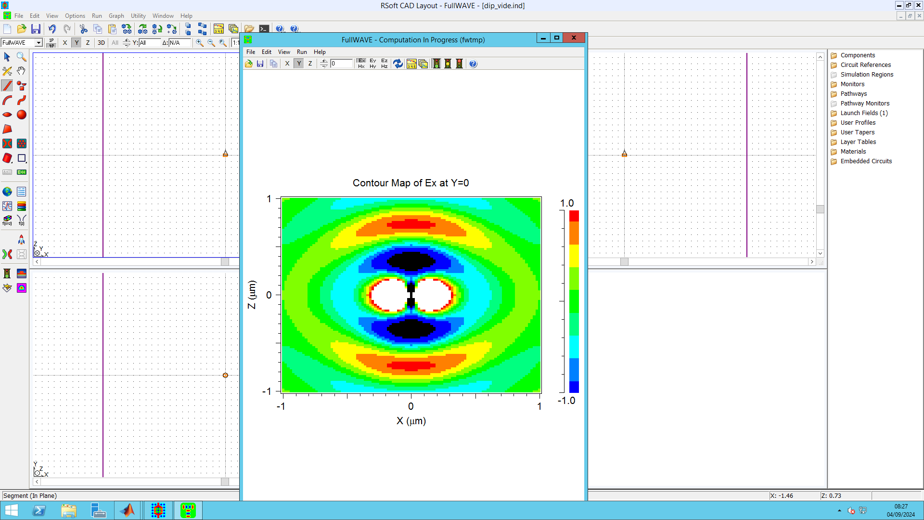
Radiation of a dipole
Numerical simulation
FDTD method
Fullwave (Synopys)
Dipole

Slide 9
FDTD method: Finite Difference Time Domain
- Maxwell’s equations resolved in space and time.
- Developed for the first time by Yee in 1966 for the low frequencies (microwaves, etc.)
- The acronym FDTD has been given by Taflove in his reference book, extension to optics
- Widely used in optics for the design and simulations of nano-optical structures.

Slide 10
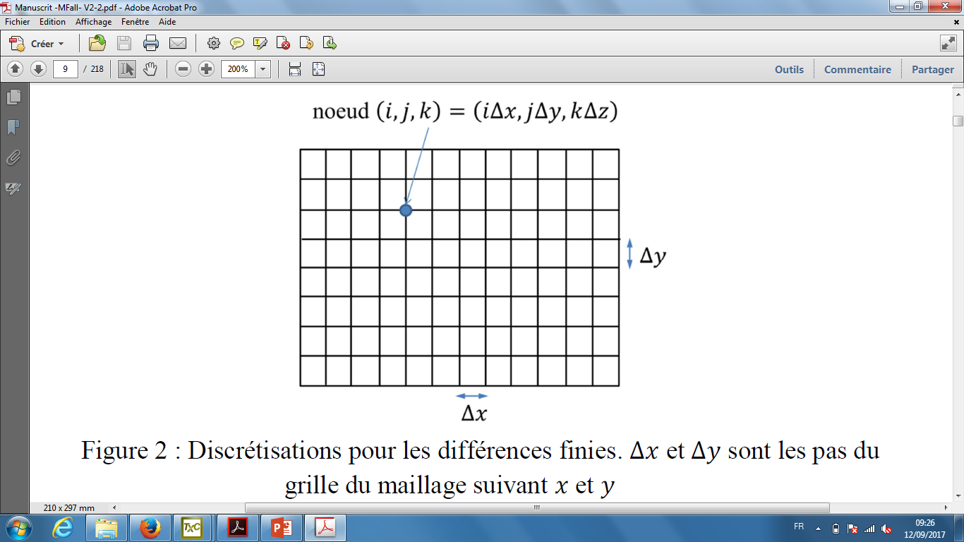
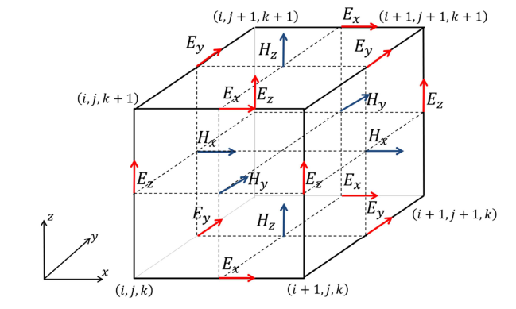
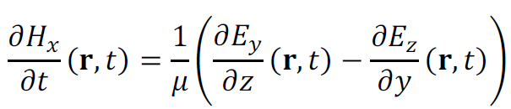
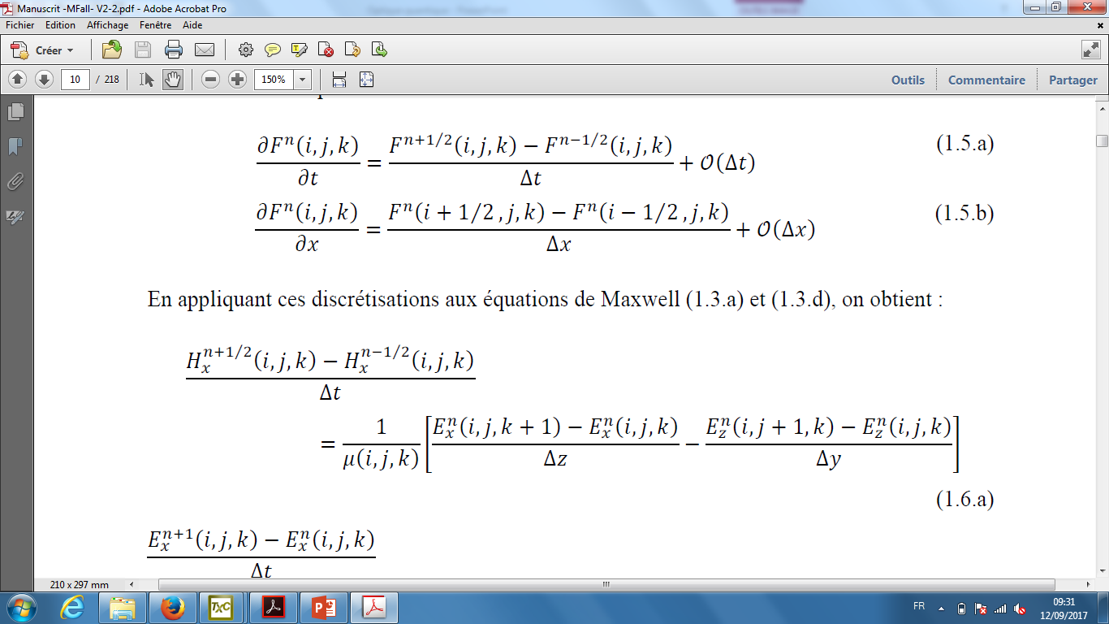
Discretization of the Maxwell’s equations in space and time
Space gridding
View of the field components in a single cell : the Yee cell

Slide 11
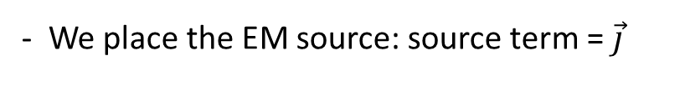
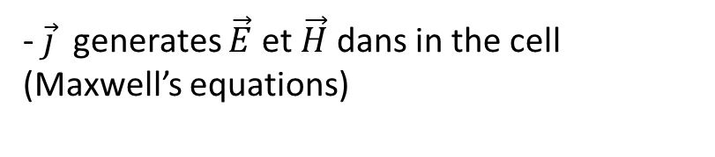
How does it work ? The algorithm
- The space and meshgrid (in space and time) ➔ computation volume
- We define objects: ε defined in each cell
- We place the EM source: source term = $\vec{j}$
- $\vec{j}$ generates $\vec{E}$ et $\vec{H}$ dans in the cell (Maxwell’s equations)
- Boundary conditions with neighbouring cells
- Field propagation in the cell (finite diff.)
- Stationnary regime reached: we stop
t

Slide 12
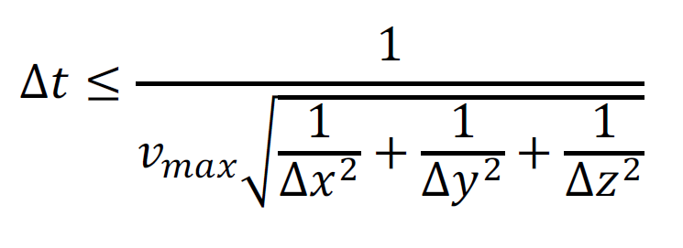
Comments
1- Finite computation volume
➔ the optical waves are reflected at the edges !!!!!!
Absorbing layer:
PML (Perfectly Matched layer)
2- Spatial and temporal discretizations are linked
➔ A rule must be fulfilled !! ➔ stability criterion

Slide 13
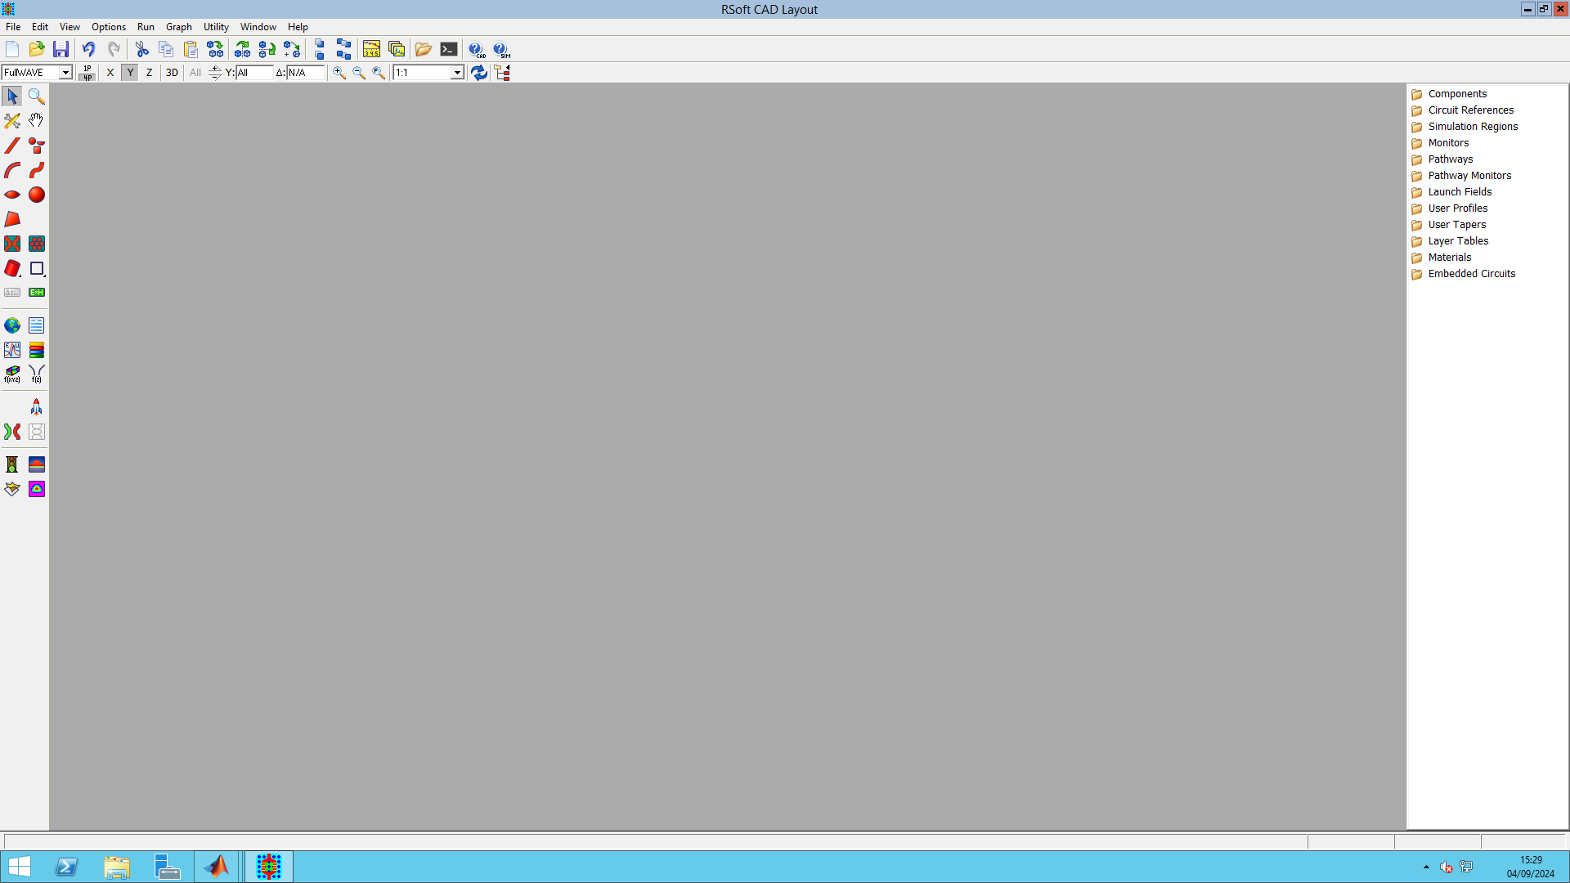
FDTD, commercial software « Fullwave »

Slide 14

MISSION #1
Characterize the EM field around the dipole
E-field
H-field
Dipole: classical analog of a quantum emitter (that is, a point-like source)
➔ Take the user’s guide

Slide 15
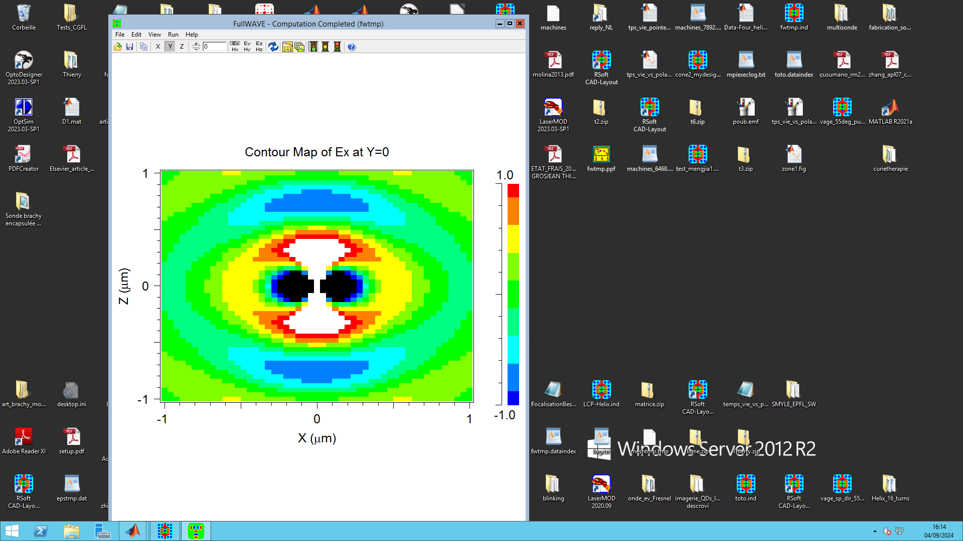
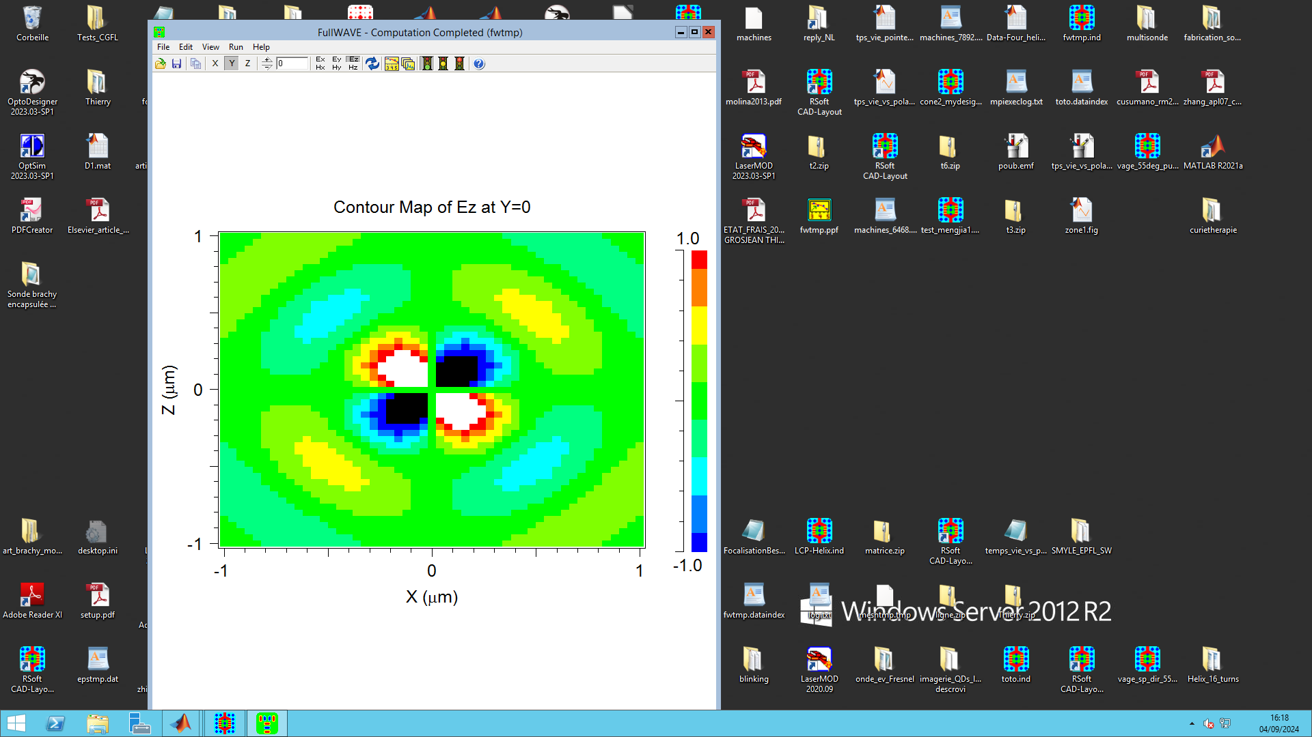
E-field
z
y
x
Ex
Ez

Slide 16
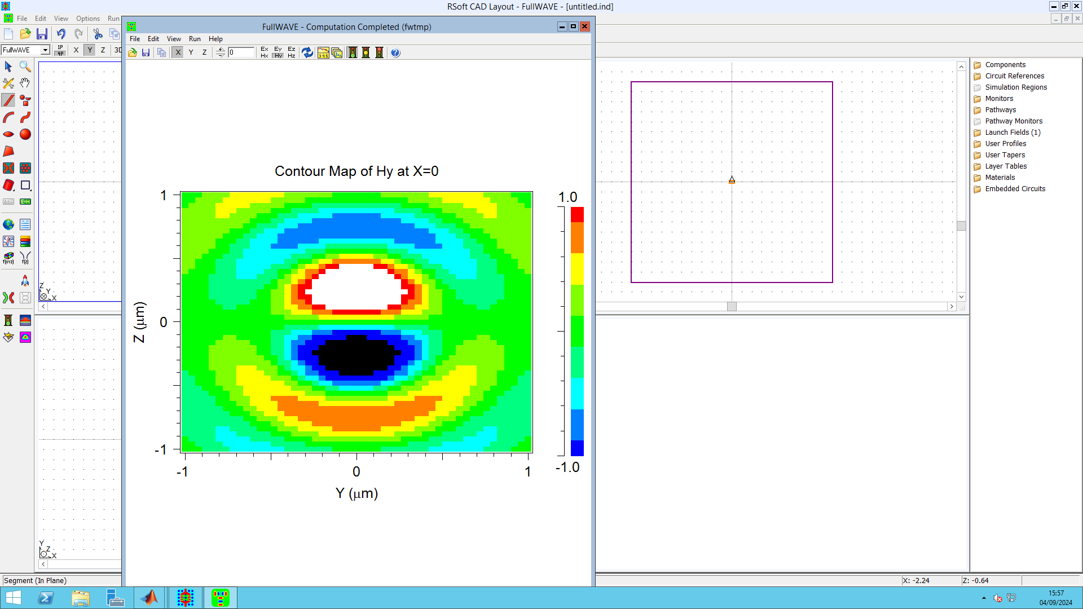
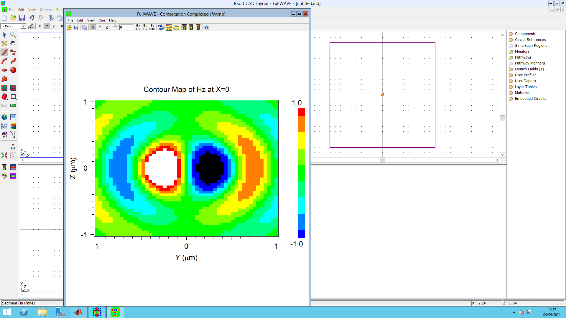
H-field
z
y
x

Slide 17
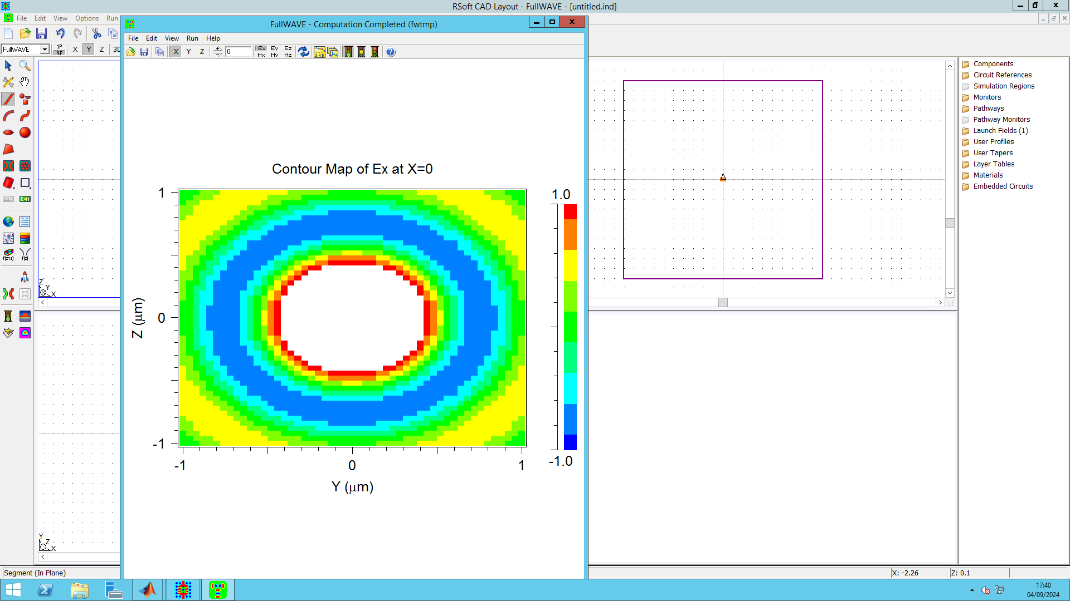
E
H
Axial symmetry

Slide 18
MISSION #2
Calculate the power radiated by a dipole
1- Dipole in vacuum
2- Dipole near an object

Slide 19
E and H fields (FDTD)
Power
➔ Poynting theorem (cf. Novotny’s book)

Slide 20
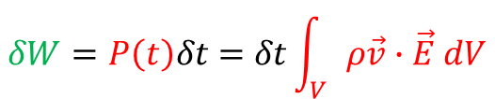
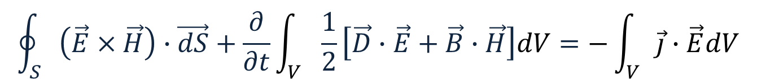
Poynting theorem
In a linear and non dispersive medium
$$\oint_{S}{\left(\vec{E}×\vec{H}\right)}∙\vec{dS}+\frac{∂}{∂t}\int_{V}{\frac{1}{2}\left[\vec{D}∙\vec{E}+\vec{B}∙\vec{H}\right]dV}=−\int_{V}{\vec{j}∙\vec{E}dV}$$
Poynting
Rate of energy dissipation within the volume (by the Lorentz force (F= ρE) acting on charges densities ρ)
Net energy flow through the surface S delimiting a volume V
Rate of change of the energy inside the volume
$$δW=P\left(t\right)δt=δt\int_{V}{ρ\vec{v}∙\vec{E} dV}$$
The exerted work

Slide 21
Poynting theorem
In a linear and non dispersive medium
$$\oint_{S}{\left(\vec{E}×\vec{H}\right)}∙\vec{dS}+\frac{∂}{∂t}\int_{V}{\frac{1}{2}\left[\vec{D}∙\vec{E}+\vec{B}∙\vec{H}\right]dV}=−\int_{V}{\vec{j}∙\vec{E}dV}$$
Poynting
RADIATION AND ABSORPTION (joule effect)
Net energy flow through the surface S delimiting a volume V
Rate of change of the energy inside the volume

Slide 22

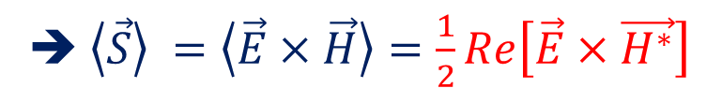
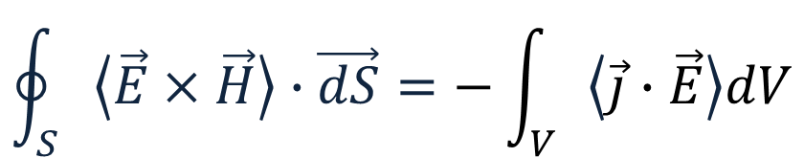
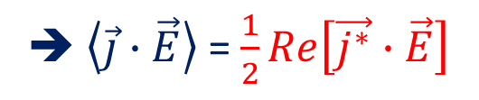
Poynting theorem
Harmonic fields in time (stationary regime), linear and non dispersive fields
Time-averaged quantities
$$\oint_{S}{\left\langle \vec{E}×\vec{H}\right\rangle }∙\vec{dS}=−\int_{V}{\left\langle \vec{j}∙\vec{E}\right\rangle dV}$$
➔ $\left\langle \vec{S}\right\rangle =\left\langle \vec{E}×\vec{H}\right\rangle =\frac{1}{2}Re\left[\vec{E}×\vec{H^{∗}}\right]$
Time averaged Poynting vector
In complex notation
➔ $\left\langle \vec{j}∙\vec{E}\right\rangle$ = $\frac{1}{2}Re\left[\vec{j^{∗}}∙\vec{E}\right]$

Slide 23
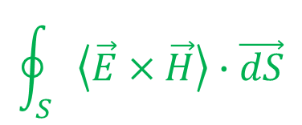
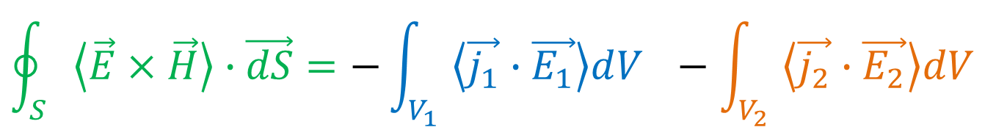
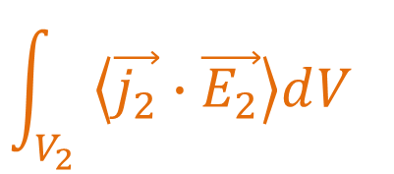
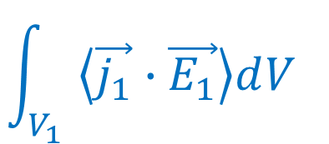
An example
$$\oint_{S}{\left\langle \vec{E}×\vec{H}\right\rangle }∙\vec{dS}$$
$$\int_{V_{2}}{\left\langle \vec{j_{2}}∙\vec{E_{2}}\right\rangle dV_{}}$$
j2
V2
V1
Source
➔ radiation
Absorption
Joule effect, etc.
j1
S
V
$$\int_{V_{1}}{\left\langle \vec{j_{1}}∙\vec{E_{1}}\right\rangle dV_{}}$$
$$\oint_{S}{\left\langle \vec{E}×\vec{H}\right\rangle }∙\vec{dS}=−\int_{V_{1}}{\left\langle \vec{j_{1}}∙\vec{E_{1}}\right\rangle dV_{}}−\int_{V_{2}}{\left\langle \vec{j_{2}}∙\vec{E_{2}}\right\rangle dV}$$

Slide 24
An example
j2
V2
V1
Source
➔ radiation
Absorption
Joule effect, etc.
j1
S
V
Power outside V
= Power radiated inside V – Power absorbed inside V

Slide 25
The source = dipole
j2
V2
Point-like source
Dipole
Absorption
Joule effect, etc.
j1
S
V
Power outside V
= Power radiated inside V – Power absorbed inside V

Slide 26
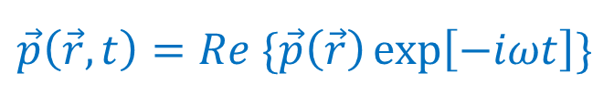

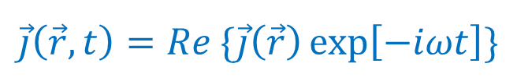

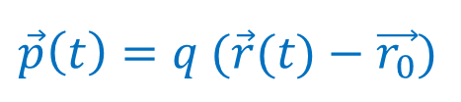
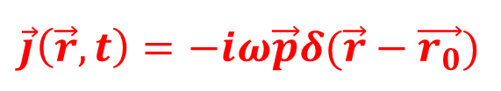

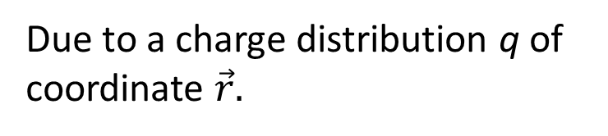
Radiating dipole
(in Harmonic regime)
Dipole moment
$$\vec{p}\left(\vec{r},t\right)=Re \{\vec{p}\left(\vec{r}\right)\exp\left[−iωt\right]\}$$
$$\vec{p}\left(t\right)=q (\vec{r}(t)−\vec{r_{0}})$$
z
$$\vec{p}=p \vec{n_{p}}$$
Current density
$${\vec{r}}_{0}$$
$$\vec{j}\left(\vec{r},t\right)=Re \{\vec{j}\left(\vec{r}\right)\exp\left[−iωt\right]\}$$
M
0
$${\vec{r}}_{}$$
Due to a charge distribution q of coordinate $\vec{r}.$
y
x
In first approximation, we have:
$$\vec{j}\left(\vec{r},t\right)=−iω\vec{p}δ(\vec{r}−\vec{r_{0}})$$

Slide 27

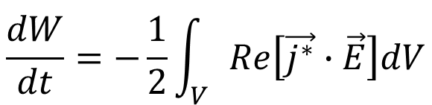

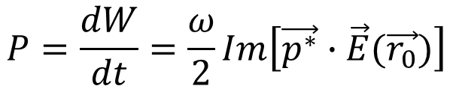
From the Poynting theorem
$$\frac{dW}{dt}=−\frac{1}{2}\int_{V}{Re\left[\vec{j^{∗}}∙\vec{E}\right]dV}$$
Dissipated energy by time unit = radiated power
Volume of the source
For a dipole, $\vec{j^{∗}}$ is replaced by :
$$iω\vec{p^{∗}}δ(\vec{r}−\vec{r_{0}})$$
$$P=\frac{dW}{dt}=\frac{ω}{2}Im\left[\vec{p^{∗}}∙\vec{E}(\vec{r_{0}})\right]$$
Radiated electric optical field at the dipole position

Slide 28



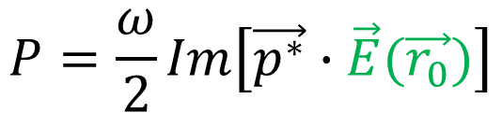


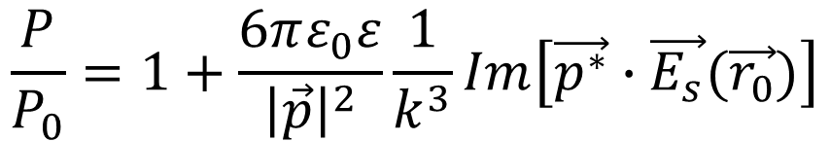
Dipole in an inhomogeneous medium
$$\vec{E_{s}}(\vec{r})$$
$$P=\frac{ω}{2}Im\left[\vec{p^{∗}}∙\vec{E}(\vec{r_{0}})\right]$$
$$\vec{E_{0}}(\vec{r})$$
$$\vec{E}\left(\vec{r_{0}}\right)$$
$$=\vec{E_{0}}\left(\vec{r_{0}}\right)$$
$$+\vec{E_{s}}\left(\vec{r_{0}}\right)$$
$$\frac{P}{P_{0}}=1+\frac{6πε_{0}ε}{{\left|\vec{p}\right|}^{2}}\frac{1}{k^{3}}Im\left[\vec{p^{∗}}∙\vec{E_{s}}(\vec{r_{0}})\right]$$
The back-scattered field changes the power
Cf. Principle of nano-optics, L. Novotny, Cambridge, 2e Ed. 2012, p239

Slide 29
An oscillating charge produces
an electromagnetic radiation
Mediates the energy dissipation from the dipole source
Has an influence back onto the oscillating charge (!!)
Retroaction of the radiating dipole on itself due to the environment

Slide 30
MISSION #2
Calculate the power radiated by a dipole
1- Dipole in vacuum
2- Dipole near an object

Slide 31
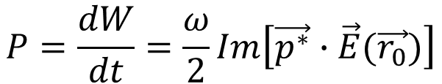
The source = dipole
j2
V2
Point-like source
Dipole
Absorption
Joule effect, etc.
j1
S
V
vacuum
?
$$P=\frac{dW}{dt}=\frac{ω}{2}Im\left[\vec{p^{∗}}∙\vec{E}(\vec{r_{0}})\right]$$
Power outside V
= Power radiated inside V
– Power absorbed inside V

Slide 32
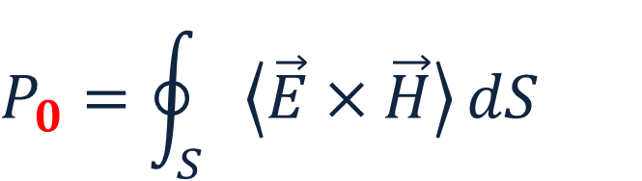
Power outside V = Power radiated inside V
Calculation of the Poynting vector flow !
Poynting’s theorem
ε
$$P_{0}=\oint_{S}{\left\langle \vec{E}×\vec{H}\right\rangle }dS$$
dipole
S
Time averaged

Slide 33
MISSION #2
Calculate the power radiated by a dipole
1- Dipole in vacuum
2- Dipole near an object

Slide 34


Poynting vector flow ?
j2
V2
Dipole
j1
Absorption
S
$$\oint_{S}{\left\langle \vec{E}×\vec{H}\right\rangle }∙\vec{dS}$$
V
Power radiated by the system « dipole+object »

Slide 35

Poynting vector flow ?
j2
V2
Dipole
j1
Absorption
V
$$\oint_{S}{\left\langle \vec{E}×\vec{H}\right\rangle }∙\vec{dS}$$
S
Power radiated by the dipole
BUT… numerical artifacts when the distance DIPOLE-OBJECT is small… OUR CASE

Slide 36

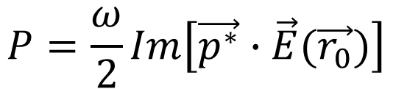

No Choice !!!!
$$\vec{p}=\left|\vec{p}\right| e^{−i(ωt+φ)}$$
?
FDTD
$$P=\frac{ω}{2}Im\left[\vec{p^{∗}}∙\vec{E}(\vec{r_{0}})\right]$$
j2
V2
Dipole
j1
Absorption
Joule effect, etc.
$$\vec{E_{0}}\left(\vec{r_{0}},t\right)=\vec{E_{0}}\left(\vec{r_{0}}\right)e^{−iωt}$$

Slide 37



Calculation of $\vec{p}$
Dipole in a homogeneous medium
Whose permittivity ε matches that of the medium at the dipole position, when the dipole interacts with the nanostructures
ε
STEP #1 :
$$\vec{p}=\left|\vec{p}\right| e^{−i(ωt+φ)}$$
STEP #2 :
$$\vec{p}=\left|\vec{p}\right| e^{−i(ωt+φ)}$$

Slide 38








STEP #1 :
$$\vec{p}=\left|\vec{p}\right| e^{−i(ωt+φ)}$$
In a homogeneous medium ➔ analytical expression of E
$$E_{z}=\frac{\left|\vec{p}\right|}{4πε_{0}ε}\frac{e^{ikR}}{R}\left[k^{2}\sin^{2}{θ}+\frac{1}{R^{2}}\left(3\cos^{2}{θ}−1\right)−\frac{ik}{R}\left(3\cos^{2}{θ}−1\right)\right]$$
z
$$\vec{E}$$
$$θ$$
$${\vec{r}}_{}$$
$$\vec{p}=p \vec{n_{p}}$$
0
$$P_{0}=\frac{{\left|\vec{p}\right|}^{2}}{12π}{\frac{ω}{ε_{0}ε}k}^{3}$$
y
$$α$$
x
Cf. Principle of nano-optics, L. Novotny, Cambridge, 2e Ed. 2012, p239

Slide 39



STEP #1 :
$$\vec{p}=\left|\vec{p}\right| e^{−i(ωt+φ)}$$
$${\left|\vec{p}\right|}^{2}=\frac{12πε_{0}ε}{ωk^{3}}P_{0}$$
ε
From analytical expression of the E-field
dipole
$$P_{0}=\oint_{S}{\vec{E}×\vec{H}}dS$$
S
From FDTD calculation

Slide 40


STEP #2 :
$$\vec{p}=\left|\vec{p}\right| e^{−i(ωt+φ)}$$
In a homogeneous medium
- Normally $φ$=0 ➔ $\vec{E }$and $\vec{p}$ are in phase
- With the FDTD $φ≪1$ (not null…)
In a inhomogeneous medium, $φ$remains unchanged

Slide 41




STEP #2 :
$$\vec{p}=\left|\vec{p}\right| e^{−i(ωt+φ)}$$
➔ Dipole in vacuum (a homogeneous medium)
$$P=\frac{ω}{2}Im\left[\vec{p^{∗}}∙\vec{E}(\vec{r_{0}})\right]$$
$$\oint_{S}{\left\langle \vec{E}×\vec{H}\right\rangle }∙\vec{dS}$$
Dipole along (0x)
$φ=f({\left|p\right|, E}_{x}\left(\vec{r_{0}}\right),P$, $ω$)
There are two solutions, only one is correct, to be tested by recalculating P

Slide 42




Dipole interacting with nanostructures
$$P=\frac{dW}{dt}=\frac{ω}{2}Im\left[\vec{p^{∗}}∙\vec{E}(\vec{r_{0}})\right]$$
$$\vec{E_{s}}(\vec{r})$$
known
FDTD
$$\vec{E_{0}}(\vec{r})$$
$$\vec{E}\left(\vec{r_{0}}\right)=\vec{E_{0}}\left(\vec{r_{0}}\right)+\vec{E_{s}}\left(\vec{r_{0}}\right)$$

Slide 43
OQA module
Classical description of a quantum emitter
Thierry Grosjean
DR, CNRS
Institut FEMTO-ST
03 81 66 64 17
thierry.grosjean@univ-fcomte.fr

Slide 44
Introduction
Definition of a quantum emitter (QE)
3 types of emitters
Individual QE in an inhomogeneous environment
Description via the quantum ElectroDynamics (ED) (just basic considerations…)
Description of the spontaneous emission
Description of the excitation
Description of fluorescence emission
Description of the spontaneous emission by the classical ED
Classical electrodynamics ?
Link between quantum and classical ED

Slide 45
I- Introduction

Slide 46
Quantum emitter:
- Light emitter (in our case)
Point-like emitter (nanometer scale) : atoms, molecules , nanoparticules.
Internal energy levels ➔ light matter interaction: ground and excited states: emission shows discrete spectral peaks
« states » ➔ electrons in orbitals defined by quantum numbers (n,l, ml, ms)
Single photon emissions
Spontaneous emission of photons (no stimulated emission)
central in nano-optics or nano-photonics

Slide 47
Single photon emission: fluorescence
The model of a fluorescent emitter:
➔2 energy states (fundamental / excited states)
1 photon
absorbé
1 emitted photon
hν1
hν2
ν1 > ν2

Slide 48
3 families of quantum emitters:
Fluorescent molecules
Quantum dots
Color centers (in diamond)

Slide 49




Jablonski Diagram
Fluorescence molecules
➔ Organic molecules
➔ Elongated shape !!
➔ Energy states

Slide 50





From the spatial point of view…
Point-like fluorescent sources➔ Dipole sources
➔ Oriented Dipole moment
Transition dipole moment
➔ For absorption and emission
Taux de fluorescence R
d

Slide 51
3 families of quantum emitters:
Fluorescent molecules
Quantum dots
Color centers (in diamond)

Slide 52

Colloidal quantum dots
➔ Semiconductor nanocristals in solution
➔ Almost spherical shape
➔ Size: on the nanoscale
Quantum dots CdSe/Zns of various sizes (1 size per bottle) – UV excitation

Slide 53


*0,00000014
*0,00000014

Slide 54


➔ Properties of Semiconductors + « quantum size effect »
➔ QD = « big atom »: two energy state system with a particle of 2-6 nm, i.e., 10 to 100 bigger than an atom ➔ easier manipulation, etc…

Slide 55
Fluorescence: involves an exciton rather than an electron
Exciton = electron-hole pair (semiconductor material)
electron
Conduction
band
Single photon
illumination
recombinaison
excitation
Valence
band
électron
hole

Slide 56

Fluorescence: involves an exciton rather than an electron
Exciton = electron-hole pair (semiconductor material)
électron
Bande de conduction
Single photon
illumination
recombinaison
excitation
Bande de valence
électron
trou

Slide 57



High emission yield/efficiency at room temperature
Photostability at room temperature
QD encapsulation: « core-shell » system
Avantages:
- Broadband absorption (semiconductor)
- quantum size effect: the size defines the emission wavelength
- Photon sources from blue to near and middle infrared !!
- Photostability at room temperature ➔ no expensive cooling
Drawbacks :
blinking
In contact to O2, blueshift of the emission wavelength

Slide 58
Broad application field: biomedical (fluorescent markers), optoelectronics, screens-TV, etc…
Dipole :
➔ Dipolar transitions for the absorption et emission (as molecules) excepted that:
Degenerated dipole moment:
➔Dipolar emission in a 2D plan,
➔Arbitrary orientation of the mission dipole in this plane (no fixed oriented dipole)
Molecule imaging
Quantum dot imaging

Slide 59
3 families of quantum emitters:
Fluorescent molecules
Quantum dots
Color centers (in diamond)

Slide 60

Vacancy in a high energy gap (5.5 eV) semiconductor: diamond
A single nitrogen atom (N) creates on a neighbouring site a vacancy ➔ « NV center »
Free electron are in play ➔ favorable to fluoresence
Lifetime of the excited state: 11 ns
Size: 10-30 nm (size of the diamond fragment which hosts the NV-center)
Easier manipulation than QDs ➔ attached at the very tip
No blinking
Fixed emission wavelength = 690 nm (no wavelength tunability)
Also used as a probe for magnetometry

Slide 61
The fluorescence, this is…
A two-step process:
Absorption of a photon
Spontaneous emission of a photon of (usually) lower energy ➔ Stokes shift
These two steps are rigorously described using quantum electrodynamics
Tiny objects on the nanoscale ➔ quantum theory

Slide 62
Introduction
Definition of a quantum emitter (QE)
3 types of emitters
Individual QE in an inhomogeneous environment
Description via the quantum ElectroDynamics (ED) (just basic considerations…)
Description of the spontaneous emission
Description of the excitation
Description of fluorescence emission
Description of the spontaneous emission by the classical ED
Classical electrodynamics ?
Link between quantum and classical ED

Slide 63

Purcell (1946) : spontaneous emission of a QE is modified by its environment
➔ QE coupled to an optical resonator (resonant optical structure such as a FP cavity, etc.)
Purcell Factor:
Quality factor of the resonator
$$F_{p}=\frac{3}{{4π}^{2}}\frac{Q}{V}{\left(\frac{λ}{n}\right)}^{3}$$
Enhancement of the emission rate
Volume of the resonant optical mode
Purcell effect: if high Q and small V, a QE emits its photon much faster : « super emitter »

Slide 64
Since Purcell (1946)
1
1966
Fluorescence lifetime modified by a non resonant optical environement
n
Drexhage et al, 1966
1981-1983
➔ Purcell effect experimentally demonstrated (Goy et al, 1983)
➔ Inhibition of the spontaneous emission in a resonant cavity (that is the opposite effect to Purcell’s… in a cavity !!) (Kleppner, 1981)
Since 2000,
Engineering of the spontaneous emission

Slide 65
By structuring the environment of a QE…
We modify its photon absorption/emission properties
20th centery
21th centery
We control its photon absorption/emissionproperties
Nanotechnologies
New fabrications facilities on the nanoscale
➔ Full control over light-matter interaction
nano-optics

Slide 66




Slide 67



Slide 68
WHY ?
Quantum emitters ➔ Single photon sources
The starting point of future quantum technologies
Need of on-demand single photon sources of controlled properties and performances
➔ nano-photonics could fullfil this requirement by accurately structuring the environment of the QE

Slide 69
Introduction
Definition of a quantum emitter (QE)
3 types of emitters
Individual QE in an inhomogeneous environment
Description via the quantum ElectroDynamics (ED) (just basic considerations…)
Description of the spontaneous emission
Description of the excitation
Description of fluorescence emission
Description of the spontaneous emission by the classical ED
Classical electrodynamics ?
Link between quantum and classical ED

Slide 70




QE in an inhomogeneous environment
hν1
QE
hν2
object
2-state model
|e>
decay
3 decay channels
$$γ_{loss}^{}$$
$$γ_{exc}^{}$$
$$γ_{r}^{}$$
$$γ_{nr}^{0}$$
excitation
|i>

Slide 71









|e>
relaxation
$γ (s^{−1})$
➔ only $γ_{r}$can be experimentally measured
$$γ_{exc}^{}$$
$$γ_{r}^{}$$
$$γ_{loss}^{}$$
$$γ_{nr}^{0}$$
excitation
|i>
$$γ_{exc}^{}$$
: excitation rate
$$γ_{r}^{}$$
: radiative decay rate ➔ Fluo
$$γ_{nr}^{0}$$
: intrinsic non-radiative decay rate
$$γ_{loss}^{}$$
: non-radiative decay rate
➔due to losses in the environement

Slide 72
Description of the spontaneous emission
|e>
decay
$$γ_{exc}^{}$$
$$γ_{r}^{}$$
$$γ_{loss}^{}$$
$$γ_{nr}^{0}$$
excitation
|i>

Slide 73




Total decay rate
$$γ {=γ}_{r}^{}{ + γ}_{loss}^{}{+ γ}_{nr}^{0}$$
$${=γ}_{nr}^{}$$
Non-radiative decay rate
Particular case, QE in vacuum
vacuum
$$γ_{}^{0} {=γ}_{r}^{0}{+ γ}_{nr}^{0}$$
$γ_{nr }^{0}$➔ Intrinsic losses which are independent of the QE env.
$${γ_{r}^{}≠γ}_{r}^{0}$$
➔ Spontaneous emission influenced by the environment of the QE (Purcell and others)

Slide 74


Lifetime of the excited state
$$τ {=\frac{1}{γ}=\frac{1}{γ_{r}^{}{ + γ}_{loss}^{}{+ γ}_{nr}^{0}} }_{}^{}$$
Emitter in vacuum
$$τ_{0} {=\frac{1}{γ}=\frac{1}{γ_{r}^{0}{+ γ}_{nr}^{0}} }_{}^{}$$

Slide 75


Quantum yield (efficiency)
Probability of a radiatively released photon
Probability of a radiative decay
$${q=\frac{γ_{r}}{γ}=\frac{γ_{r}}{γ_{r}^{}{ + γ}_{loss}^{}{+ γ}_{nr}^{0}} }_{}^{}$$
Emitter in vaccum
$${q_{i}=\frac{γ_{r}^{0}}{γ^{0}}=\frac{γ_{r}^{0}}{γ_{r}^{0}{+ γ}_{nr}^{0}} }_{}^{}$$
Intrinsic quantum yield

Slide 76
Description of the QE excitation
|e>
decay
$$γ_{exc}^{}$$
$$γ_{r}^{}$$
$$γ_{loss}^{}$$
$$γ_{nr}^{0}$$
excitation
|i>

Slide 77



Case of an QE excitation with weak optical power : excitation well below the saturation regime
➔ The QE is most of the time in its ground state
$$γ_{exc}^{}=|{\vec{n_{p} }∙\vec{E}\left(\vec{r_{0}},ω_{abs}\right)|}^{2}$$
$\vec{n_{p} } :$ unit vector defining the dipole moment of the QE
$\vec{E}$ : electric optical field for excitation
$\vec{r_{0}}$ : position vector of the QE
$ω_{abs}$ : angular frequency at excitation
Signal fluo
Emitter in vacuum
saturation
$$γ_{exc}^{0}=|{\vec{n_{p} }∙\vec{E_{0}}\left(\vec{r_{0}},ω_{abs}\right)|}^{2}$$
Iexc

Slide 78
Description of fluorescence emission
|e>
relaxation
$$γ_{exc}^{}$$
$$γ_{r}^{}$$
$$γ_{loss}^{}$$
$$γ_{nr}^{0}$$
excitation
|i>

Slide 79

Fluorescence rate
➔below saturation threshold
$$γ_{em}^{}={q γ}_{exc}^{}$$
Experimentally measurable parameter (with a photon counter)

Slide 80
Introduction
Definition of a quantum emitter (QE)
3 types of emitters
Individual QE in an inhomogeneous environment
Description via the quantum ElectroDynamics (ED) (just basic considerations…)
Description of the spontaneous emission
Description of the excitation
Description of fluorescence emission
Description of the spontaneous emission by the classical ED
Classical electrodynamics ?
Link between quantum and classical ED

Slide 81
|e>
decay
$$γ_{exc}^{}$$
$$γ_{r}^{}$$
$$γ_{loss}^{}$$
$$γ_{nr}^{0}$$
excitation
|i>

Slide 82
Why ?
Nanoscale systems : « QE + environment » are often too complex to be rigorously resolved/described by quantum electrodynamics
Classical Electrodynamics is much more simple to implement
➔ Numerous numerical methods based on Maxwell’s equations are nowadays commercially available (FDTD, FMM, etc.)

Slide 83
Électrodynamique classique ?
QE ➔ Radiating dipole
Power calculation from electromagnetic waves
➔ Poynting’s theorem
Electromagnetic waves
dipole
object

Slide 84

IMPORTANT !
The link between
quantum and classical electrodynamics
In the case of a « weak coupling » between the QE and its environment, we have:
$$\frac{γ}{γ^{0}}=\frac{P}{P_{0}}$$
Quantum formalism of the QE
Classical formalism of the radiating dipole

Slide 85

$$\frac{γ}{γ^{0}}=\frac{P}{P_{0}}$$
A link between quantum and classical approaches is possible at the expense of a normalisation process
We can only predict a relative spontaneous emission induced by the environment of the QE. No quantitative prediction of the emission rate…
BUT the problem is greatly simplified

Slide 86


In the following: PERFECT EMITTERS
$$γ_{nr}^{0}=0$$
$$q_{i}^{}=1$$
|e>
$$γ_{exc}^{}$$
$$γ_{r}^{}$$
$$γ_{loss}^{}$$
$$γ_{nr}^{0}$$
excitation
|i>

Slide 87









Problem to resolve
2 decay channels to simulate
$$γ_{r}$$
1
hν
|e>
$$γ_{exc}^{}$$
$$γ_{r}^{}$$
$$γ_{loss}^{}$$
excitation
|i>
$$γ_{loss}$$
2
$$\frac{γ_{r} }{γ^{0}} ?,$$
$$\frac{γ_{loss} }{γ^{0}} ?,$$
$$\frac{γ}{γ^{0}} ?,$$
$$q ?$$

Slide 88

What do we have ?
$$\frac{γ}{γ^{0}}=\frac{P}{P_{0}}$$
Classical electrodynamics
Numerical methods based on Maxwell’s equations
Analytical description of a radiating dipole
➔ dipolar field (analytic formula)
Poynting’s theorem

Slide 89
TP :
Spontaneous emission (SE) of a quantum emitter near a structure : quantum description via classical electrodynamics

Slide 90





Objective
Prediction of the change of SE of a single emitter positioned near a (nano)structure
2 cases under study :
$\vec{p}$ // (0x)
$\vec{p}$ // (0z)
Air
z
y
x
Emission at λ = 800 nm
Au
$$\frac{γ_{r} }{γ^{0}},$$
$$\frac{γ_{loss} }{γ^{0}},$$
$$\frac{γ}{γ^{0}},$$
$$q ??$$

Slide 91

Methodology
Quantum formalism of the QE
$$\frac{γ}{γ^{0}}=\frac{P}{P_{0}}$$
Classical formalism of the radiating dipole
➔ Power calculation from a radiating dipole
P0 and P have to be calculated with the dipole positioned in two media of the same permittivity !!!
ε

Slide 92






Methodology
Quantum formalism of the QE
$$\frac{γ}{γ^{0}}=\frac{P}{P_{0}}$$
Classical formalism of the radiating dipole
ε
ε
ε
S
S
$$P_{0}=\oint_{S}{\vec{E}×\vec{H}}dS$$
$$P_{r}=\oint_{S}{\vec{E}×\vec{H}}dS$$
$$P=\frac{ω}{2}Im\left[\vec{p^{∗}}∙\vec{E}(\vec{r_{0}})\right]$$
$$⇒\frac{γ_{r} }{γ^{0}}$$
$$⇒\frac{γ}{γ^{0}}$$

Slide 93






Methodology
$$\frac{γ_{r} }{γ^{0}},$$
$$\frac{γ}{γ^{0}},$$
$$\frac{γ_{loss} }{γ^{0}},$$
$$q$$
$\frac{γ_{loss} }{γ^{0}}=$ $\frac{γ}{γ^{0}} − \frac{γ_{r} }{γ^{0}}$
$q$ = $\frac{γ_{r} }{γ}$

